Slide 1
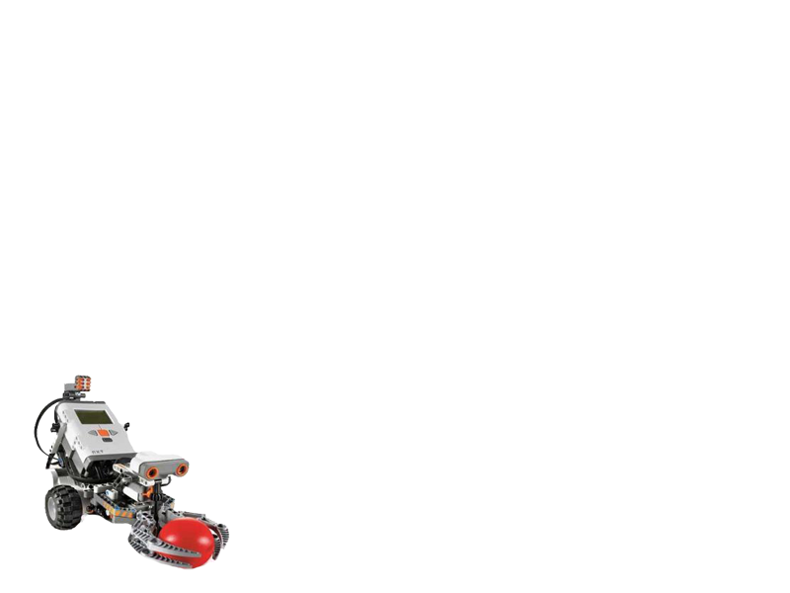
Final Year Project
Lego Robot Guided by Wi-Fi (QYA2)
Presented by:
Li Chun Kit (Ash)
So Hung Wai (Rex)

Slide 2
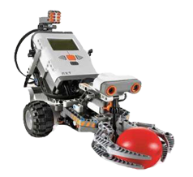
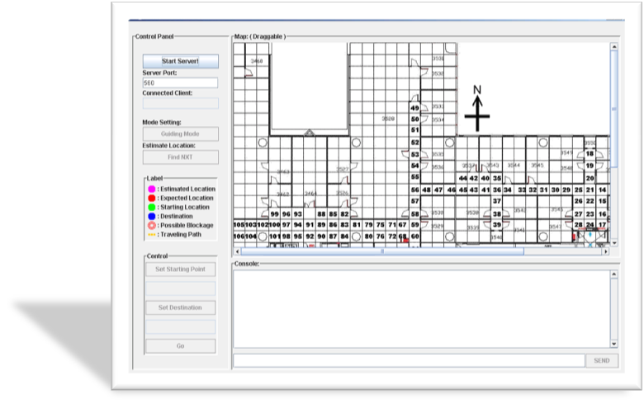
Outline
Introduction
Video Demo
System Functions
- Localization
- Self-Guiding
- Obstacles Detection
- Auto Data Collection
Conclusion
Q&A

Slide 3
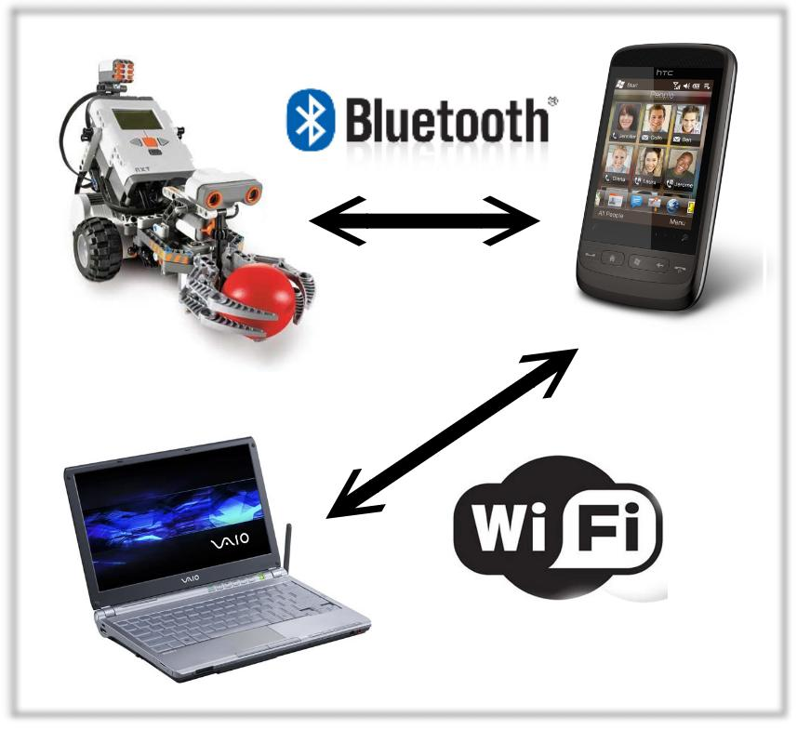
Introduction
Aims
Wi-Fi Indoor localization
Self-Guiding
Lego robot as the media
to move and collect data
automatically
Figure 1. The client-server architecture.

Slide 4

Video Demo

Slide 5
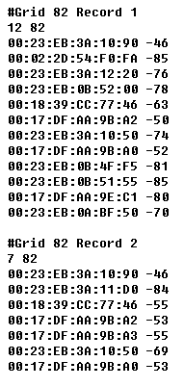
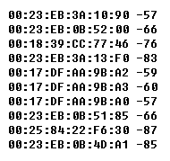


Localization
Offline Phrase | Online Phrase
Data collected for establishing the training database | Data collected is compared with the training database
Figure 3. Record received at a grid cell during online phrase.
Machine Learning Algorithm
Estimated Location
Figure 2. Records in training database.

Slide 6

Localization :
K-Nearest Neighbor (KNN)
KNN classified the user trace by comparing the similarity of the user trace with the existing classified records.
The similarity is computed using :
K=10
K=4
For those k records with highest similarity, i.e. with lowest Euclidean Distance, the grid cell having the highest number of occurrence in the list is declared as the estimated location.
Example of KNN Classification. For k=4, the user trace is classified to be grid k; while it is classified to be grid i when k=10.
Euclidean Distance
i
Records in grid i, j and k
j
k

Slide 7
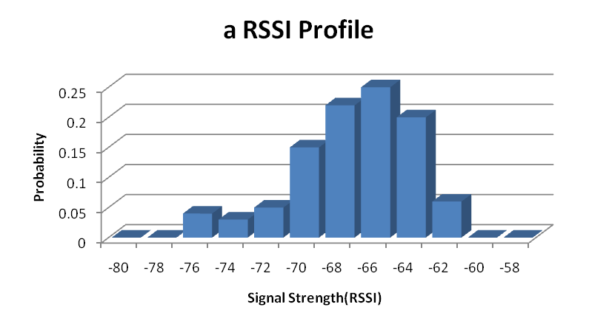
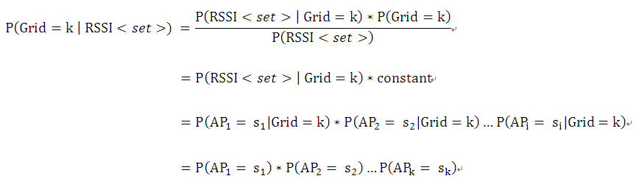
Localization:
Bayesian Probability
Bayesian approach is based on signal strength distribution on each grid cell.
It helps mitigate the random error due to dynamic signal strength across air.
It works by multiplying the probability of each access point’s RSSI in the user trace.
Figure 5. A histogram showing the RSSI distribution of an access point at a grid cell

Slide 8
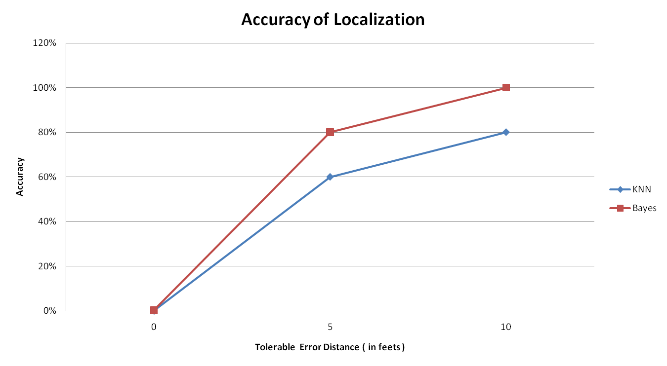
Algorithm Accuracy

